Slide 1
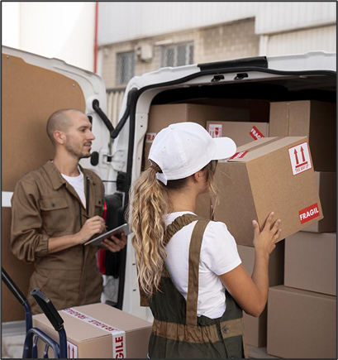
UPS project
Group 3

Slide 2
Table of contents
01
04
Driver Detection
Introduction
02
Website Integration
05
Reusable Rugged
03
Database Connection
06
Conclusion
The method that we used to detect drivers
The user interface
The method of how to use code to secure the box
How database works with python

Slide 3
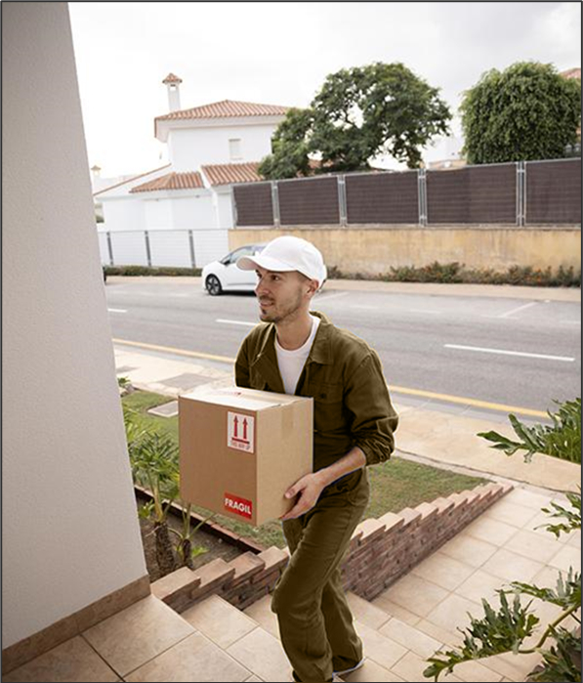
01
Introduction
Purpose of your application and what it does

Slide 4
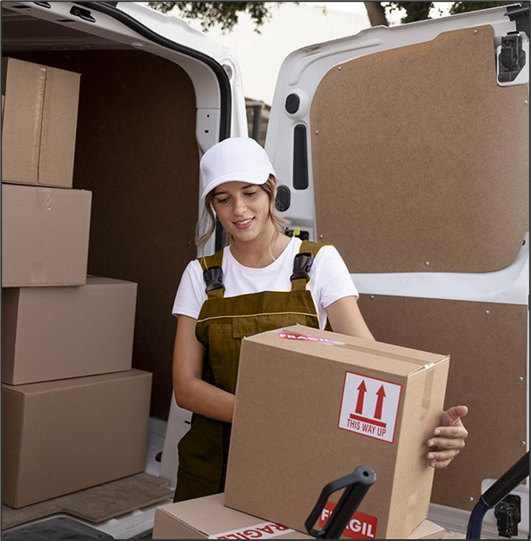
What application does?
The application uses Python to detect when a driver is close to a package pickup location and updates the package status in real-time.

Slide 5
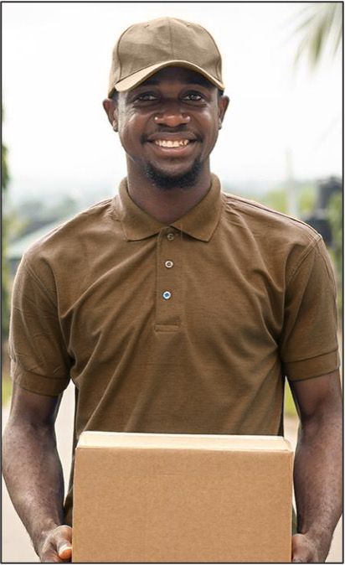
02
Website Integration
The user can use the application as the interface to interact with the system.

Slide 6
Website Integration
Used Python to integrate the database with the website.
Users can view the status of their package and rate the company using the data stored in the database.
Using Python Flask web frameworks to create the website.

Slide 7
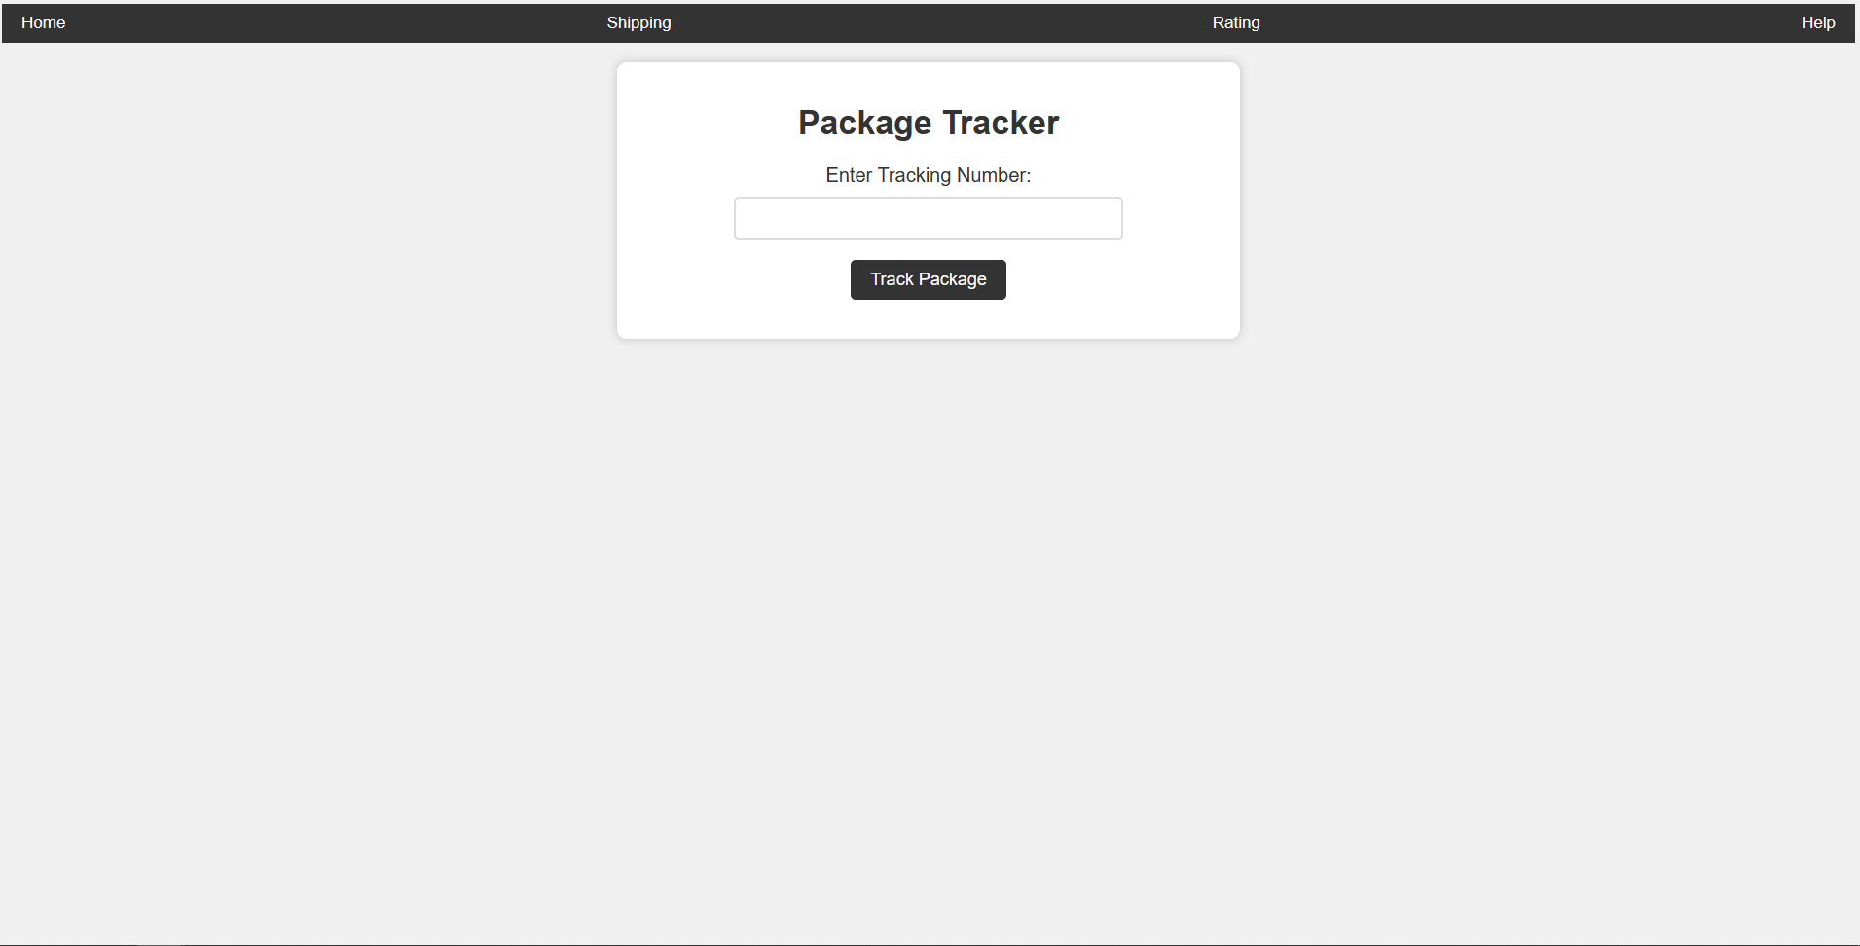
Homepage

Slide 8
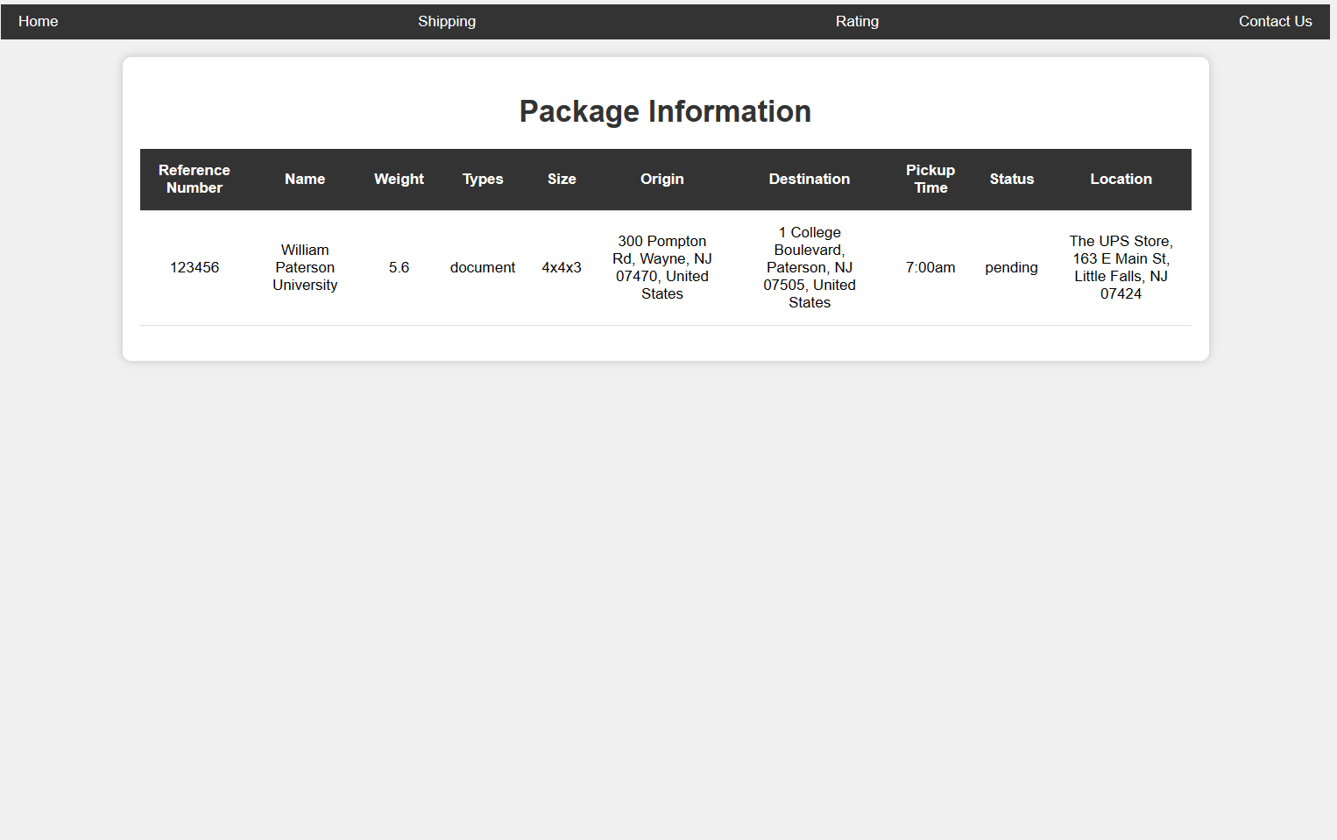
Package Status

Slide 9
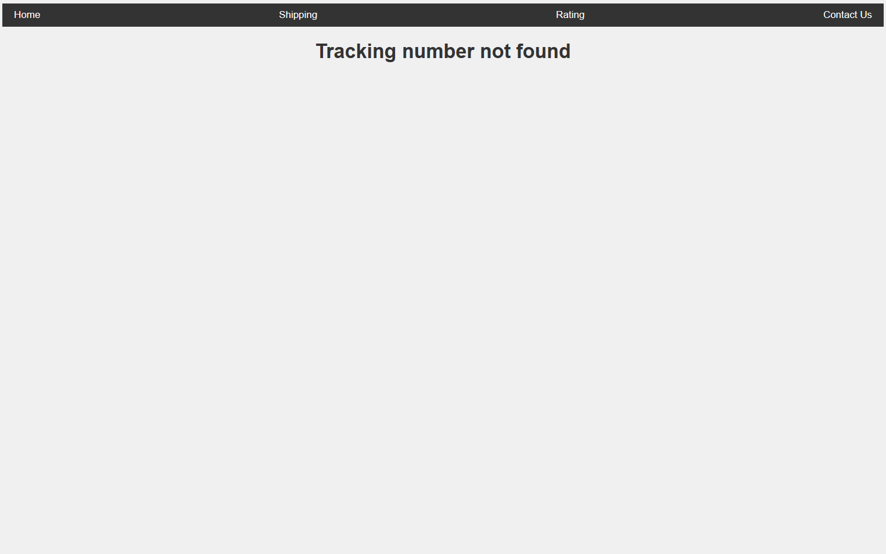
Package Not Found

Slide 10
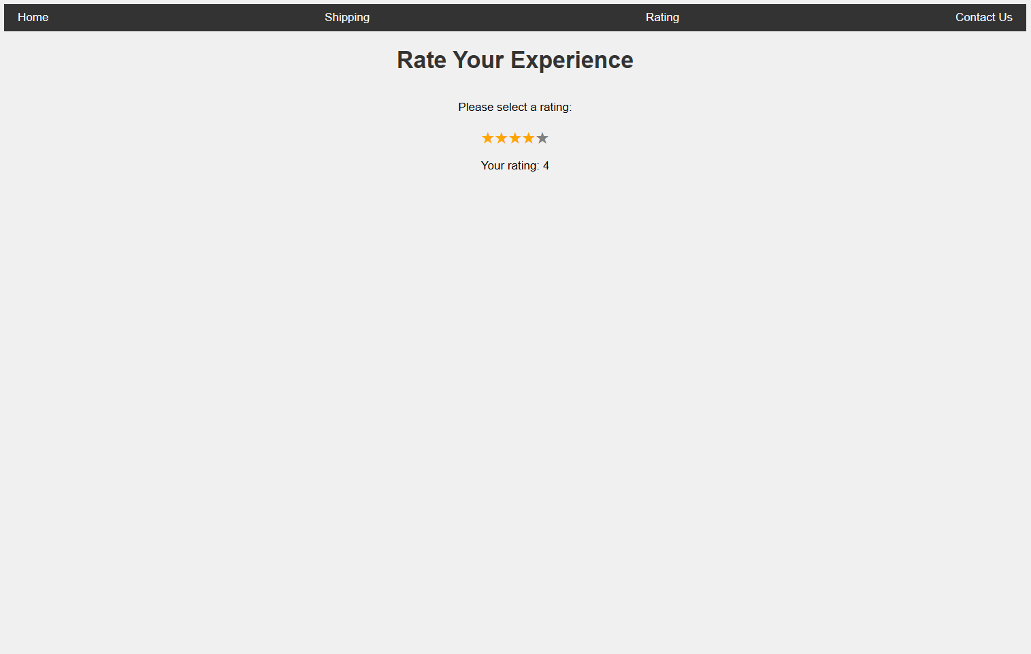
Rating

Slide 11
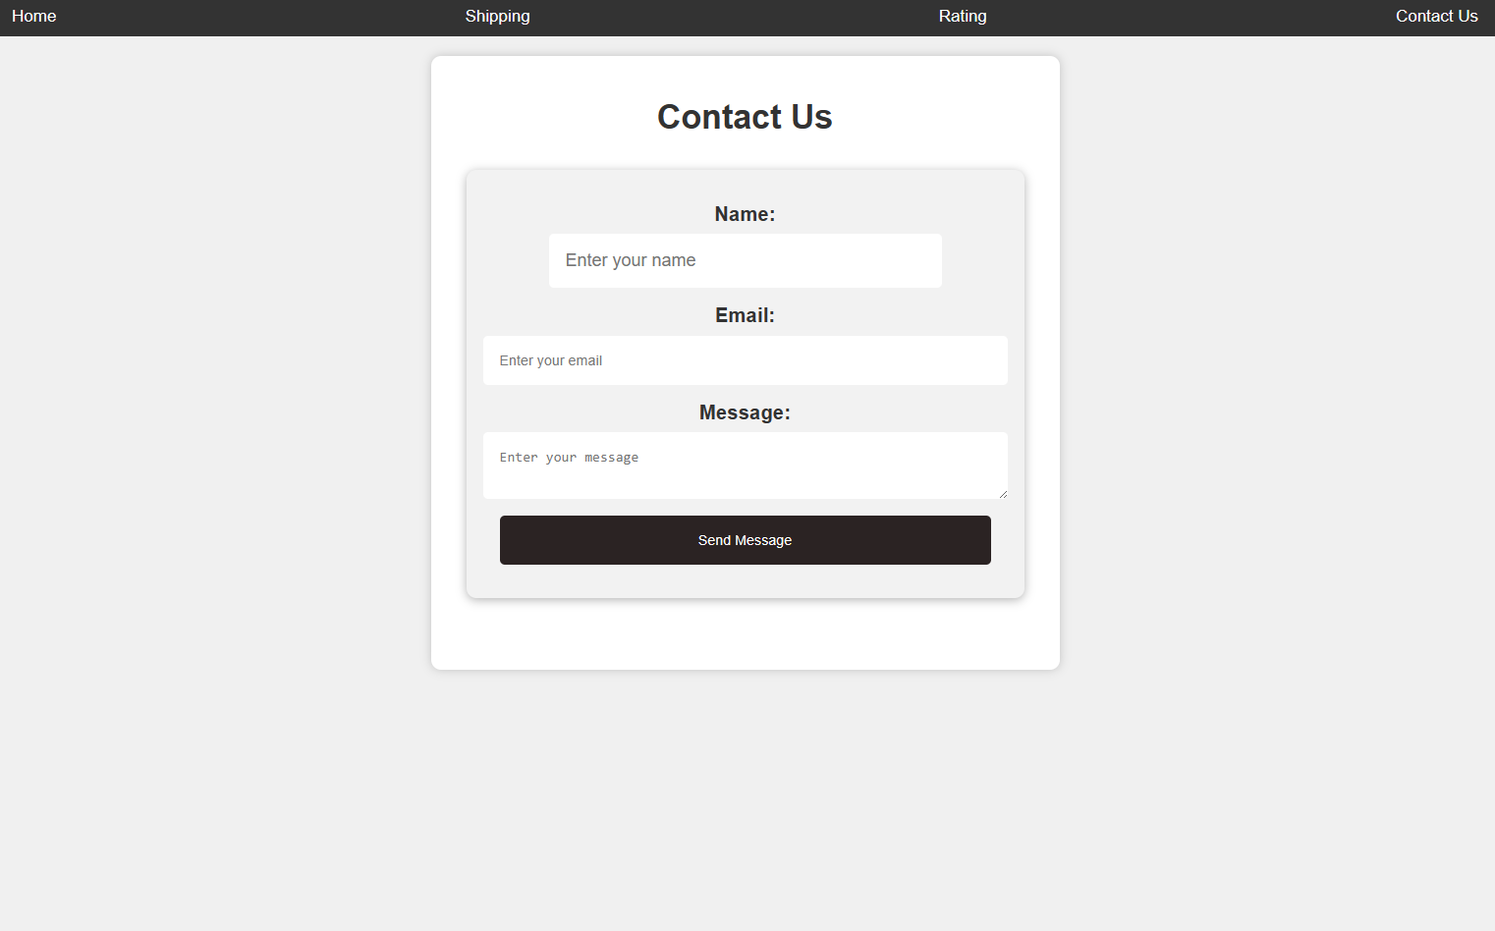
Contact Us

Slide 12
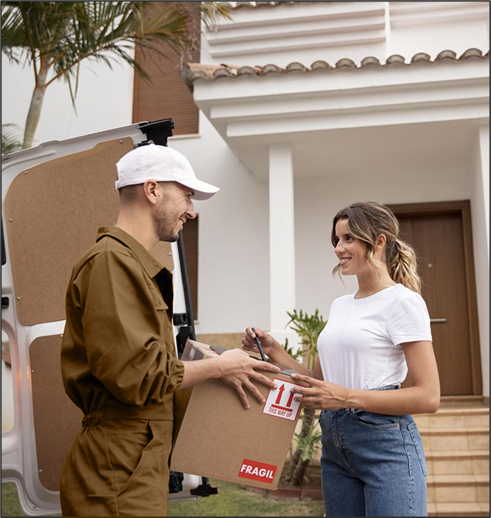
03
Database connection
How does database work with the applications

Slide 13
Database benefits Storing data Query-able Easy to use Performance Accessibility
A user privilege
Security

Slide 14
Database connection
Using Python to connect to a database and store information that users input from the website.
Using MySQL for the database program
Using Python's database library : mysql.connector is used to interact with it.

Slide 15
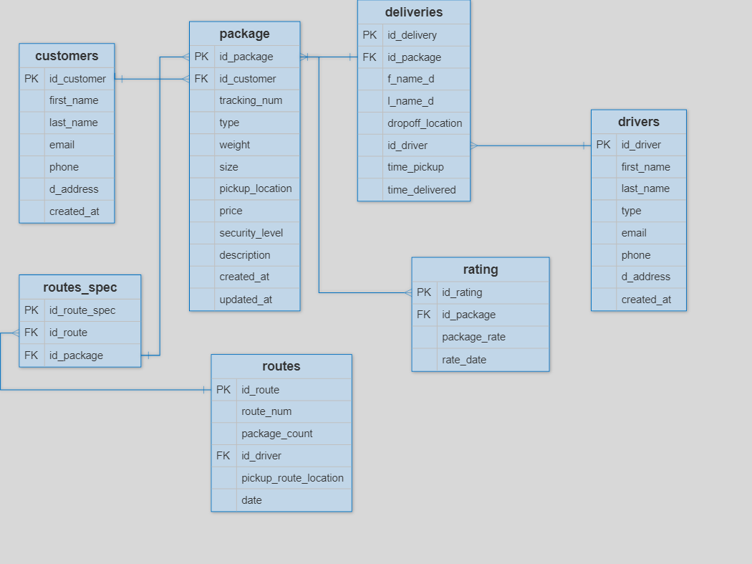

Slide 16

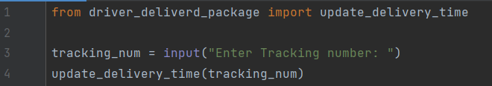

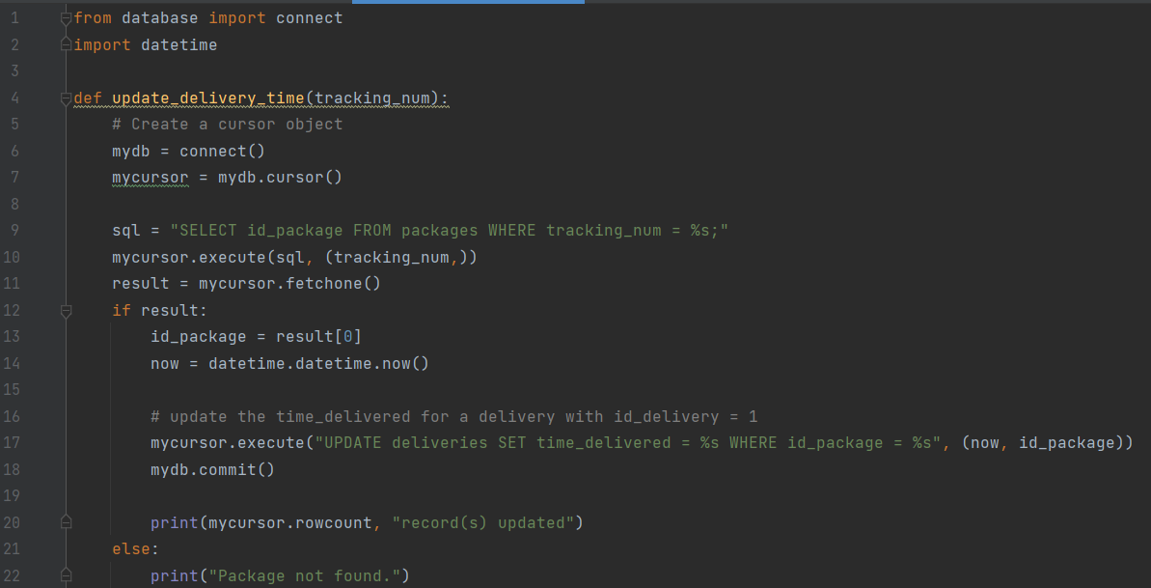
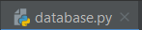
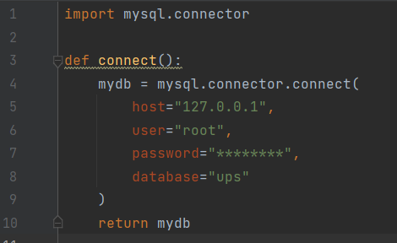
Python code

Slide 17
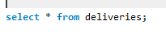
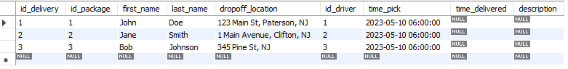
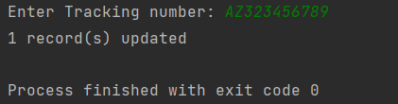
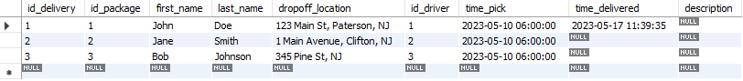
Database

Slide 18

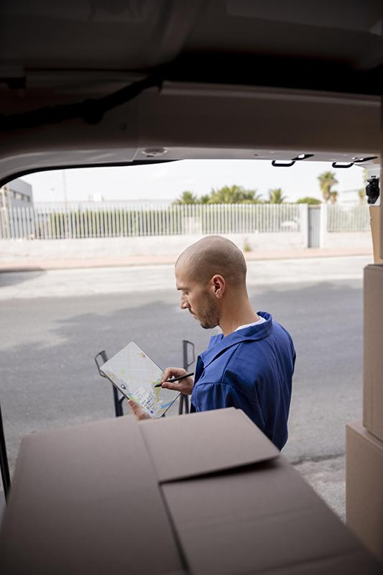
04
Driver Detection
How the application detects the driver

Slide 19
Driver Detection
We will use Python to retrieve the driver's location in real-time from a database that contains GPS
Additionally, we will develop a backend application that the driver can use to change the package status by scanning a barcode and clicking 'done' once the package is delivered.

Slide 20
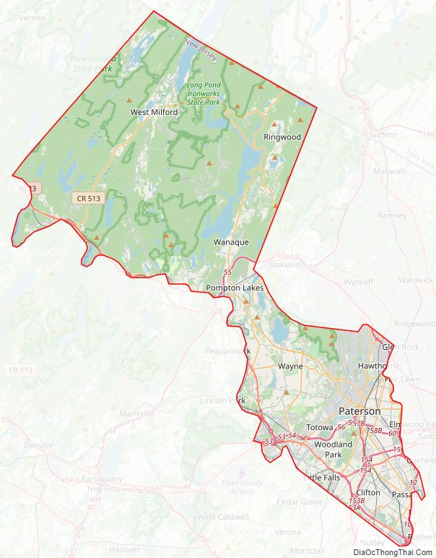
Passiac County
Driver1
Point B
Destination drop off package
Point A
Driver2
Original pickup of the package
Driver3
Point C
Destination drop off the package

Slide 21


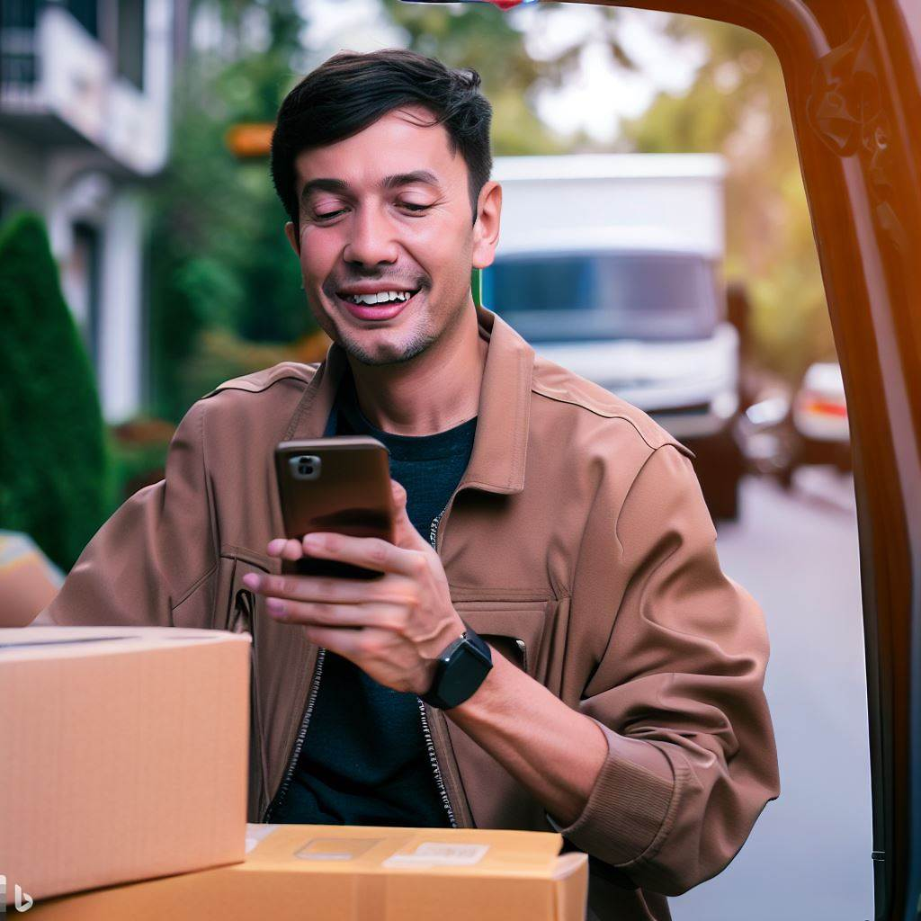
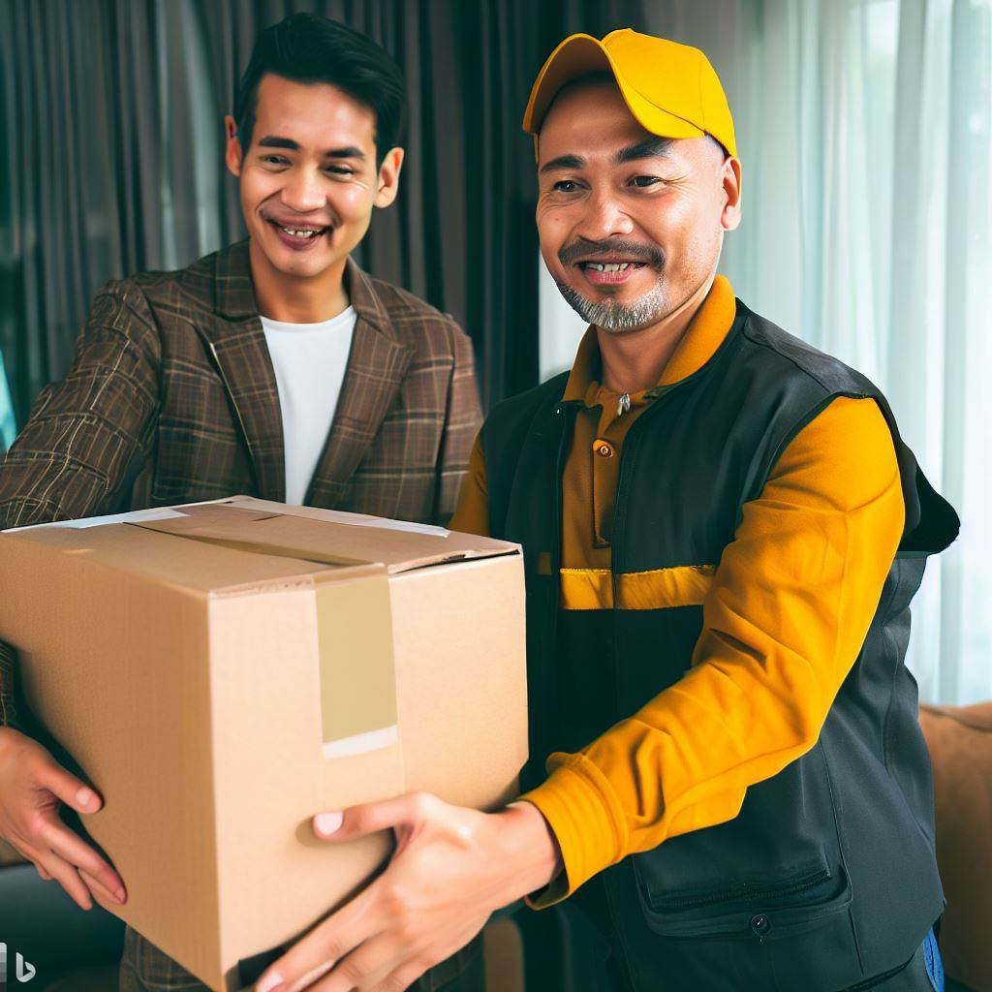
Our process
01
02
03
04
User
Database
Driver
Receiver
The user submits the request on the website
The system will store the information in the database and notify the nearest driver about the location.
The package will be picked up by the driver from the alert location. The driver will deliver it if the destination is on his route. Otherwise, he will give it to another driver
Receiver enters the code so it can be opened
Whenever a change is made in the system, it is automatically reflected in the database. The user can see the latest status of the system on their screen in real-time.

Slide 22

06
Reusable Rugged Folder
How to secure the important package

Slide 23
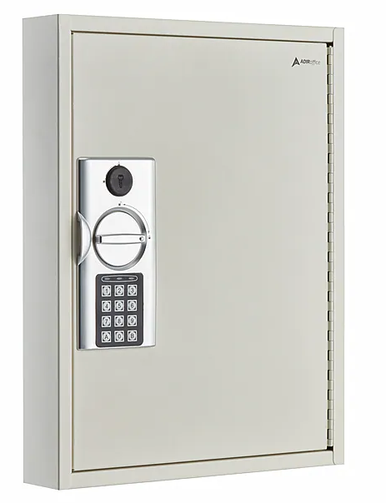

Slide 24

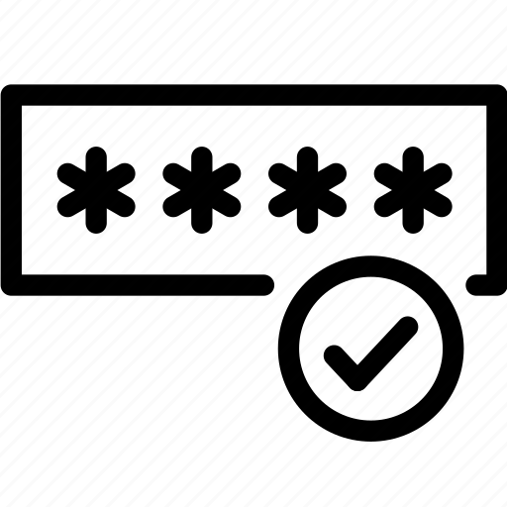

Reusable Rugged Folder
Pick up
The receiver
The driver picks up the package and places it in the secure folder
They will enter the secure code and opens the package
Reuse it
Delivery
Clear the code and reuse it

Slide 25
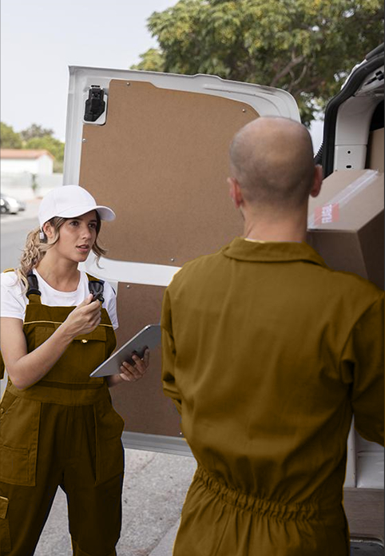
06
Conclusion

Slide 26
Conclusion
Summarize the key points of the application and how Python is used to create it. You could also discuss any future plans for the application or any improvements that could be made.

Slide 27




Our team
Database
Python
Website
Mohamed
Aksarapuk
Jeremy
Website
Kayla
Created the database table information
Connecting database and website
Designing website
Designing website

Slide 28
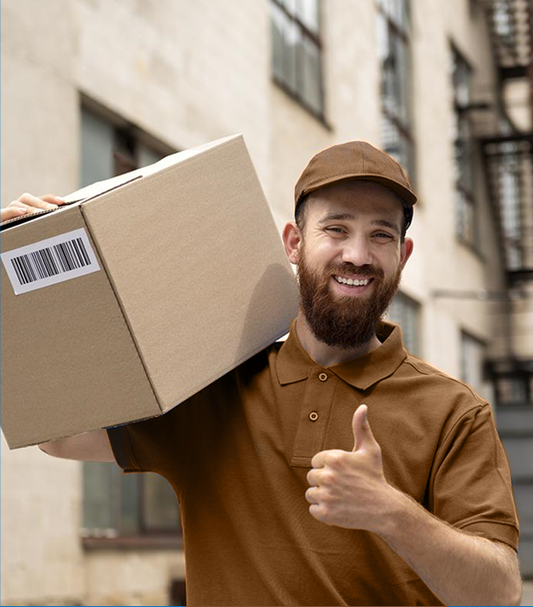
Thanks!

Slide 29
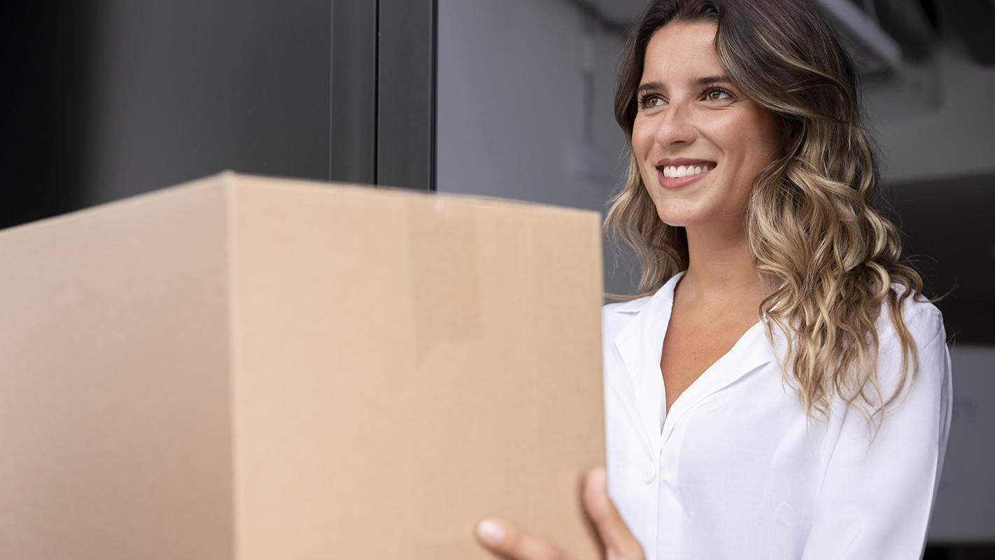
Any questions?

